Slide 1
Nutrition and Chronic Kidney Disease
Tara Gray &
Katie Gallagher

Slide 2
Kidney Function
Kidneys:
Remove waste
Remove drugs from the body
Regulate body fluids
Release hormones that regulate blood pressure
Produce active vitamin D that promotes strong, healthy bone growth
Controls production of red blood cells

Slide 3
What is Kidney Disease?
Kidney disease is a progressive loss in renal function over a period of months or years.
Chronic kidney disease may be caused by diabetes, high blood pressure and other disorders along with accidents.
When Kidney disease progresses, it may eventually lead to kidney failure, which requires dialysis or a kidney transplant to maintain life.

Slide 4
Nutrient Guidelines
 | Totals for the Day | Per Meal/Snack
kCal | 2000 | 400
Protein (.6-.8/kg) | 58.6-78.2 g | 11.6-15.6 g
Sodium | 2000 mg | 200-400 mg
Potassium | 2000-3000 mg | < 400 mg
Phosphorous | 800-1200 mg | 160-240 mg
Calcium | 1200 mg | 240 mg
CKD patients much be aware of their potassium, sodium, phosphorus, calcium, fluids, and protein levels and intake.

Slide 5
Sodium
When your kidneys are not healthy, extra sodium and fluid build up in your body.
This can cause:
swollen ankles,
puffiness, a
rise in blood pressure
shortness of breath
fluid around your heart and lungs. See the following table for suggestions on how to reduce sodium in your diet.

Slide 6
Potassium
Potassium is an important mineral in the blood that helps your muscles and heart work properly. The amount of potassium the body can handle depends on the stage of kidney disease.
High Potassium Foods Include:
Apricot
Bran/Bran products
Avocado
Artichoke
Chocolate
Banana
Granola
Cantaloupe
Baked Beans
Milk
Dried fruits
Blood Potassium Levels
Safe Zone | 3.5-5.0
Caution Zone | 5.1-6.0
Danger Zone | > 6.0
Almost all foods contain some potassium so serving size is vital.

Slide 7
Phosphorus
Your kidneys may not be able to remove enough phosphorus from your blood which causes the level of phosphorus in the blood to be too high.
Some patients are prescribed a phosphate binder to take with meals.
Phosphorus is found in large amounts in:
Dairy products such as milk, cheese, pudding, yogurt, ice cream, and pudding.
Dried beans and peas such as kidney beans, split peas, and lentils
Nuts and peanut butter
Beverages such as cocoa, beer, and dark cola drinks.

Slide 8
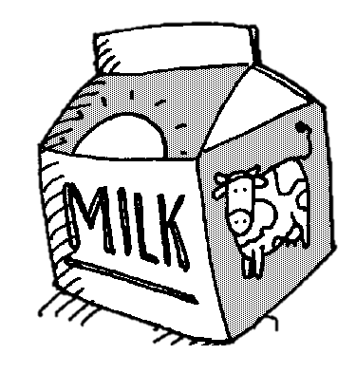
Calcium
Calcium is a mineral that is important for building strong bones
Vitamin D cannot be synthesized in the kidneys to produce the active form of vitamin which works to maintain calcium and phosphate homeostasis.
A patient may take a calcium supplement and a special prescription form of vitamin D
Foods that are good sources of calcium tend to be high in phosphorus

Slide 9
Nutritional Analysis: Meat Option
Food | Calories | Protein | Carbs | Fat | Sat Fat | Cholesterol | Na | P | K | Ca
Shrimp Tacos and Pineapple Salsa – 1 taco | 133 | 5 g | 12 g | 5.5g | 2.8 g | 90 mg | 39 mg | 39.5 mg | 45 mg | 42 mg
Cool Cucumber Soup- 1/2 cup | 58 | 1.5 g | 4.5 g | 3.75 g | 1.91 g | 6.93 mg | 72 mg | 145 mg | 36 mg | 45 mg
Phosphorus Free Drop Biscuits- 1 biscuit | 65 | 1.5 g | 12 g | 3 g | 5.8 g | 13 mg | 44 mg | 44 mg | 10 mg | 8 mg
Hot Apple Cider- ½ cup | 44 | 0 g | 11 g | 0 g | 0 g | 0 mg | 22 mg | 6 mg | 88 mg | 8 mg
Spice Rubbed Corn- ½ corn cob | 75 | 4.5 g | 26 g | 2.5 g | 0 g | 0 mg | 22 mg | 78 mg | 194 mg | 7 mg
Glazed Carrots- ¼ cup | 44 | 0.3 g | 7.7 g | 1.5 g | 0.54 g | 0 mg | 12 mg | 7 mg | 37 mg | 23 mg
Pumpkin Layer Cheesecake – 1/10 of 9” of round pan | 95 | 2.5 g | 9 g | 8.5 g | 6.8 g | 46 mg | 61 mg | 20 mg | 25 mg | 14 mg
Total | 514 | 15.37 g | 82.2 g | 24.75 g | 17.8 g | 155.9 mg | 272 mg | 339 mg | 435 mg | 147 mg

Slide 10
Nutritional Analysis: Vegetarian Option
Food | Calories | Protein | Carbs | Fat | Sat Fat | Cholesterol | Na | P | K | Ca
Fall Harvest Orzo Salad ¼ cup | 137 | 3 g | 19 g | 5.5 g | 1.2 g | 5 mg | 60 mg | 26 mg | 76 mg | 60 mg
Cool Cucumber Soup- ½ cup | 58 | 1.5 g | 4.5 g | 3.75 g | 1.91 g | 6.93 mg | 72 mg | 145 mg | 36 mg | 45 mg
Phosphorus Free Drop Biscuits- 1 biscuit | 65 | 1.5 g | 12 g | 3 g | 5.8 g | 13 mg | 44 mg | 44 mg | 10 mg | 8 mg
Hot Apple Cider- ½ cup | 44 | 0 g | 11 g | 0 | 0 g | 0 mg | 22 mg | 6 mg | 88 mg | 8 mg
Spice Rubbed Corn- ½ corn cob | 75 | 4.5 g | 26 g | 2.5 g | 0 g | 0 mg | 22 mg | 78 mg | 194 mg | 7 mg
Glazed Carrots- 1/4 cup | 44 | 0.3 g | 7.7 g | 1.5 g | 0.54 g | 0 mg | 12 mg | 7 mg | 37 mg | 23 mg
Pumpkin Layer Cheesecake – 1/10 of 9” of round pan | 95 | 2.5 g | 9 g | 8.5 g | 6.8 g | 46 mg | 61 mg | 20 mg | 25 mg | 14 mg
Total | 518 | 13.3 g | 89.2 g | 24.75 g | 16.25 g | 70.93 mg | 293 mg | 326 mg | 466 mg | 165 mg

Slide 11
Why We Chose This Menu:
We chose this many because it offers a wide variety of delicious foods that provide low levels of sodium and potassium while providing adequate levels of phosphorus and calcium.
The foods we chose are appetizing to even the non-CKD client.

Slide 12
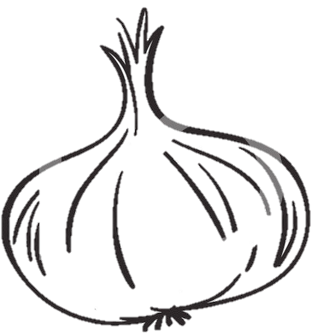
Teaching Lesson for Client
Sodium is a major concern for CKD patients
Creating strong flavors in food can be difficult without spices and seasonings containing added sodium
It is possible to create delicious menu items that are still low in sodium!

Slide 13
Tips For Spicing Up Foods:
LIMIT THE AMOUNT OF… | ACCEPTABLE SUBSTITUTES
SALT & SALT SEASONINGS | Fresh garlic, fresh onion, garlic powder, onion powder, black pepper, lemon juice, low-sodium/salt-free seasoning blends, vinegar
SALTY FOODS | Homemade or low-sodium sauces and salad dressings; vinegar; dry mustard; unsalted popcorn, pretzels, tortilla or corn chips
CURED FOODS | Fresh beef, veal, pork, poultry, fish, eggs
LUNCHEON MEATS | Low-salt deli meats
PROCESSED FOODS | Natural cheese (1-2 oz per week) Homemade or low-sodium soups, canned food without added salt Homemade casseroles without added salt, made with fresh or raw vegetables, fresh meat, rice, pasta, or unsalted canned vegetables

