Slide 1
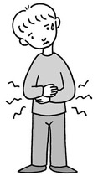
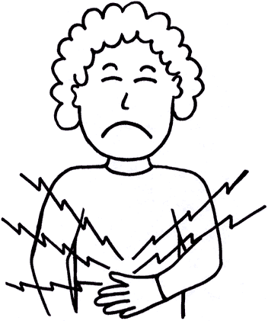
Notes:
Common Allergy – eat something and don’t feel well to depict the result of an allergy.
Sick male – koni005x.blog.shinobi.jp
Sick female - www.ageofautism.com250 × 299

Slide 2
Notes:
Common Allergies
Bread (gluten allergy) - www.clipartbest.com
Carbonate beverages - reccenterwreck.com
Chocolate - foodwallpaper.info
Citrus - www.womansworld.in
Fish/ shellfish - www.gograph.com
Mushrooms - www.fotosearch.com
Peanuts - m-y-d-s.com
Onion - www.clipart-box.com
Paprika - www.seriouseats.com
Pineapple – webclipart.about.com

Slide 3
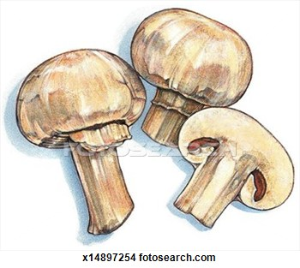
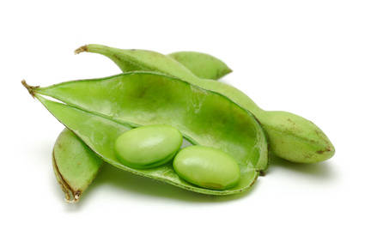

Slide 4
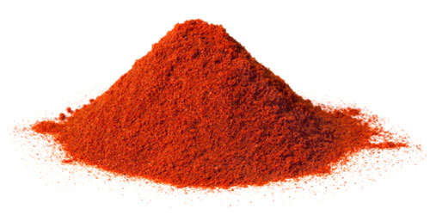
Notes:
Common Allergies –
Soy - www.bressmer-oils.com
Strawberry - www.medicalnewstoday.com
Tomato - www.jfsorlando.org

Slide 5
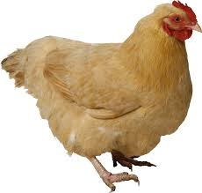
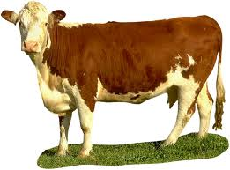
Notes:
1. rachelwarbelow.com
2. www.evolvingappetites.com
3. www.wisegeek.com
4. www.shutterstock.com

Slide 6
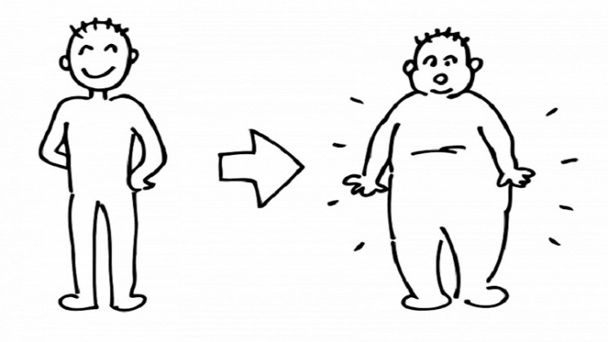
Notes:
Weight Status:
Scale – healthtopic.net
Weight increase - www.buzzthrough.com

Slide 7
Diabetes?
Albanian | Diabet
Arabic | مرض السكري
Armenian | շաքարախտ
Belarusian | дыябет
Bosnian | dijabetes
Bulgarian | диабет
Catalan | diabetis
Chinese | 糖尿病
Croatian | dijabetes
Czech | cukrovka
Esperanto | diabeto
Estonian | diabeet
Fillipino | dyabetis
French | diabète
Notes:
Diebetes

Slide 8
Diabetes?
Georgian | დიაბეტი
Greek | διαβήτης
Gujarati | ડાયાબિટીસ
Haitian Creole | dyabèt
Hausa | ciwon sukari
Hebrew | סוכרת
Hindi | मधुमेह
Hmong | Mob ntshav qab zib
Hungarian | cukorbaj
Italian | diabete
Japanese | 糖尿病
Korean | 당뇨병
Latvian | diabēts
Lithuanian | diabetas

Slide 9
Diabetes?
Nepali | मधुमेह
Persian | دیابت
Polish | cukrzyca
Romanian | diabet
Russian | диабет
Serbian | дијабетес
Slovak | cukrovka
Swahili | ugonjwa wa kisukari
Thai | โรคเบาหวาน
Turkish | diyabet
Vietnamese | bệnh tiểu đường

Slide 10
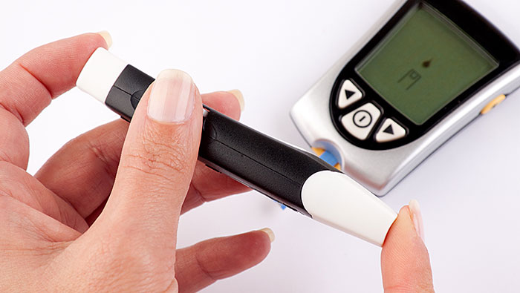
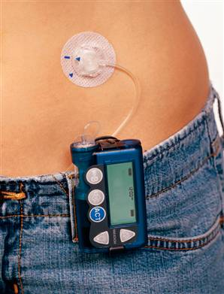
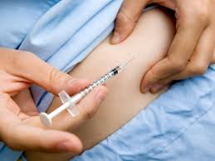
Notes:
Diabetes - www.goredforwomen.org
Pump - www.diabetespharmacist.com
Injection - www.womenshealthandcare.com

Slide 11
Notes:
Do you drink alcohol?
1. www.cancercouncil.com.au
2. www.rowperfect.co.uk

Slide 12
Notes:
Ascites?
3. www.activeforever.com
4. www.nytimes.com

Slide 13
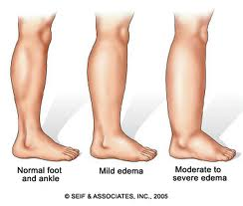
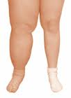
Notes:
Edema?
1. www.tabletsmanual.com
2. www.health.ny.gov

Slide 14
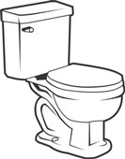
Notes:
Stool
1. Chart – articles.mercola.com
2. Restroom – www.multiplemayhemmamma.com
3. Toilet - home-design-information.com

Slide 15
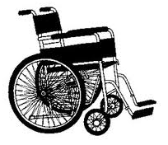
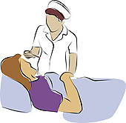
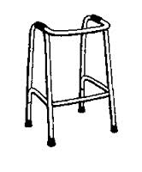
Notes:
Function
1. walk - powerlisting.wikia.com
2. bedridden - www.gograph.com
3. wheel chair – www.freeclipartnow.com
4. walker - www.pageresource.com

Slide 16
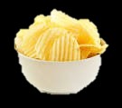

Slide 17
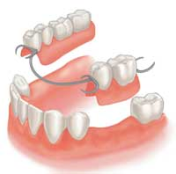
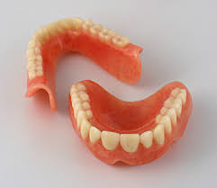
Notes:
1. www.taylorviewdentistry.com
2. www.allprodentalcare.com

Slide 18
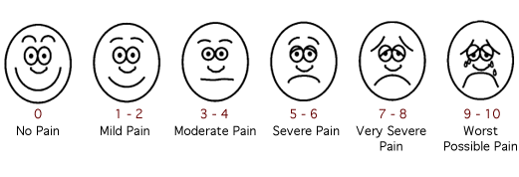
Notes:
1. www.cts.usc.edu

Slide 19
Notes:
Yes or No:
www.clipartbest.com

